Slide 1
8085-unit 1
Timing diagram for memory read & memory write cycles

Slide 2
Processor cycles
The sequence of operations that a processor has to carry out while executing the instruction is called instruction cylce.
Each instruction cycle of a processor in turn consists of a number of machine cycles.
The machine cycles are the basic operations performed by the processor.
To execute an instruction, the processor executes one or more machine cycles in a particular sequence.
The machine cycles of a processor are also called processor cycles. The manufactures of microprocessors define the timings and status of various signals during the processor cycles.

Slide 3
In general, the instruction cycle of an instruction can be divided into two sub cycles.
1) Fetch cycle
2) Execute cycle
The fetch cycle is executed to fetch the opcode from memory and the execute cycle is executed to decode the instruction and to perform the work specified by the instruction.

Slide 4
Machine cycles of 8085
The 8085 microprocessor has seven basic machine cycles. They are as follows.
1) Opcode fetch cycle (4T 0r 6T)
2) Memory read cycle (3T)
3) Memory write cycle(3T)
4) IO read cycle (3T)
5) IO write cycle(3T)
6) Interrupt acknowledge cycle (6T or 12T)
7) Bus idle cycle (2T or 3T)

Slide 5
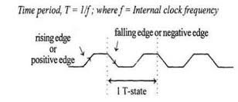
The processor takes a definite time to execute the machine cycles. The time taken by the processor to execute a machine cycle is expressed in T states.
One T-state is equal to the time period of the internal clock signal of the processor.

Slide 6
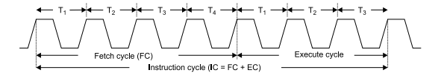

Slide 7
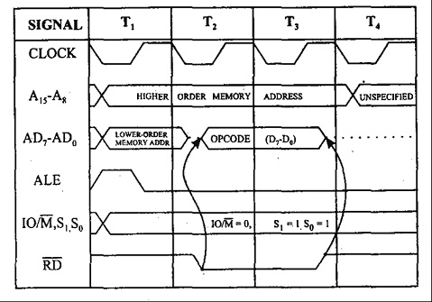
Opcode Fetch
This cycle is used to fetch the opcode from the memory
This is the first maschine cycle of every instruction
It is a compulsory machine cycle
It is generally of 4T states.
During T1
A₁₅-A₈ contains the higher byte of the address
As ALE is high AD₇-AD₀ contains the lower byte of the address
Since it is an opcode fetch cycle S1 and S0 go high
Since it a memory operation IO/M goes low
During T2
As ALE goes low address is removed from AD7-AD0
AS RD goes low, data appears on AD7-AD0
During T3
Data remains on AD7-AD0 till RD is low
During T4
T4 stat is used by the microprocessor to decode the opcode

Slide 8
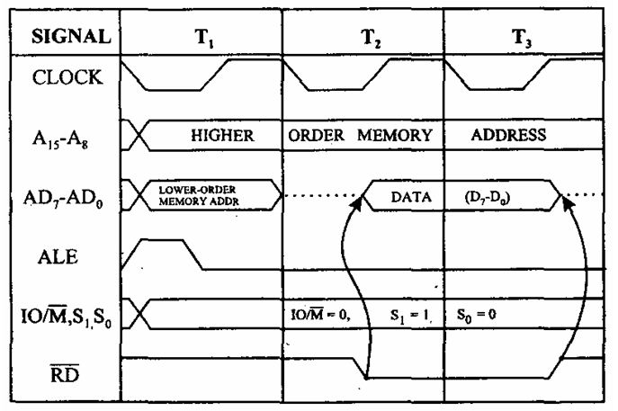
Memory Read
During T1
A₁₅-A₈ contains the higher byte of the address
As ALE is high AD₇-AD₀ contains the lower byte of the address
Since it is a memory read cycle S1 goes high and S0 go low
Since it a memory operation IO/M goes low
During T2
As ALE goes low address is removed from AD7-AD0
AS RD goes low, data appears on AD7-AD0
During T3
Data remains on AD7-AD0 till RD is low

Slide 9
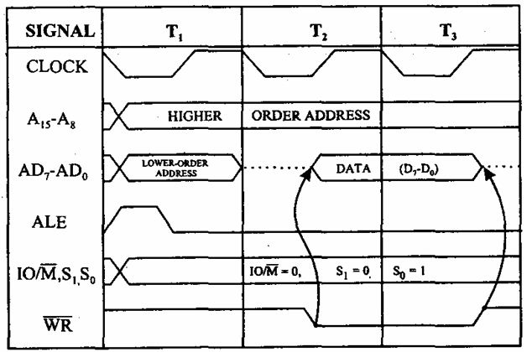
Memory write
During T1
A₁₅-A₈ contains the higher byte of the address
As ALE is high AD₇-AD₀ contains the lower byte of the address
Since it is a memory write cycle S0 goes high
Since it a memory operation IO/M goes low
During T2
As ALE goes low address is removed from AD7-AD0
AS RD goes low, data appears on AD7-AD0
During T3
Data remains on AD7-AD0 till WR is low

Slide 10
INTERRUPT
The process of interrupting the normal program execution to carry out a specific task/work is referred to as interrupt.
The interrupt is initiated by a signal generated by an external device or by a signal generated internally to the processor.
When a microprocessor receives an interrupt signal is stops executing current normal program, save the status (or content) of various registers in stack and then the processor executes a subroutine /procedure in order to perform the specific task/work requested by the interrupt.
The interrupts are useful for efficient data transfer between processor and peripheral.

Slide 11
Classification of Interrupts
In general the interrupts can be classified in the following three ways.
i. Hardware and software interrupts
ii. Vectored and non-vectored interrupts
iii. Maskable and non-maskable interrupts
Hardware and software interrupts
The interrupts initiated by external hardware by sending an appropriate signal to the interrupt pin of the microprocessor is called hardware interrupt. The 8085 has five interrupt pins TRAP, RST 7.5, RST 6.5, RST 5.5 and INTR.
The software interrupts are program instructions. These instructions are inserted at derived locations in a program. The software interrupts of 8085 are RST 0, RST 1, RST 2, RST 3, RST 4, RST 5, RST 6 and RST 7.

Slide 12
Vectored and non-vectored
When an interrupt signal is accepted by the microprocessor, if the program control automatically branches to a specific address (called vector address) then the interrupt is called vectored interrupts.
In non-vectored interrupt there is no specific address for storing the interrupt service routine. Hence the interrupting device should give the address of the interrupt service routing.

Slide 13
Maskable and Non-maskable
The processors have the facility for accepting or rejecting hardware interrupts. Programming the processor to reject an interrupt is referred to as masking or disabling and programming the processor to accept an interrupt is referred to as unmasking or enabling.
In 8085 the interrupts RST 7.5, RST 6.5 and RST 5.5 can be masked/unmasked using SIM (set interrupt mask) instruction. All the hardware interrupts except TRAP are disabled by executing DI instruction and they are enabled by EI instruction.
The interrupts whose request can be either accepted or rejected by the processor are called maskable interrupts (RST 7.5, RST 6.5 ,RST 5.5 and INTR). The interrupts whose request has to be definitely accepted (or cannot be neglected) by the processor are called non-maskable interrupts (TRAP)

Slide 14
Priorities of the Interrupt
When all the interrupts are enabled, the priority of hardware interrupts from highest to lowest is
TRAP ( it is a non-maskable interrupt)
RST 7.5
RST 6.5
RST 5.5 and
INTR

Slide 15
Addressing modes
Every instruction of a program has to operate on a data. The method specifying the data to be operated by the instructions called addressing. The 8085 supports the following five addressing modes.
Direct addressing
Register addressing
Register indirect addressing
Immediate addressing
Implied addressing/implicit addressing

Slide 16
i) Direct Addressing
In direct addressing mode, the address of the data is specified in the instruction. The data will be in memory. In this addressing mode, the program instructions and data can be stored in different memory locations.
Example: LDA 1050H -load the data available in memory location 1050H in accumulator
ii) Register addressing
In register addressing mode, the instruction specifies the name of the Register in which the data is available.
Example: MOV A, B - move the content of B register to A
iii) Register indirect addressing
In this mode, the instruction specifies the name of the register in which the address of the data is available. Here the data will be in memory and the address will be in a register pair.
Example: MOV A, M - the memory data addressed by HL pair is moved to A-register

Slide 17
iV) Immediate addressing
The data is specified in the instruction itself. The data will be a part of the program instruction.
Example: MVI B, 3EH – move the data 3EH given in the instruction to B register
v) Implied addressing
The instruction itself specifies the data to operated.
Example: CMA - complement the content of accumulator.

